Slide 1
Pro-tect Security
By:- Disha Sharma
Muskan Jain
Riya Agarwal

Slide 2
Problem Description
Smart security System

Slide 3
USP
A person cannot break in through the door without triggering the alarm.
It is installed on inside of the house, the intruder being unaware of any such system and hence cannot bypass it.
Can be remotely operated even if a person forgets to lock the door while leaving their home, they can lock the door from any where.
Wireless, which saves money of wiring and is low maintenance.
Keyless, so no need to carry keys everywhere, and thus no need to worry about losing them.
Unlike most existing security systems it does not require continuous monitoring.
A pocket friendly security device.
Provides very vast range, giving an edge over the existing technologies like Bluetooth.
Compatible with mostly all electrical locks.

Slide 4
Future Implementations
A camera can be interfaced and put in place of the peephole, which would click a picture of anyone who tries to break in.
We can also use face recognition to automatically open the door for the owner and family.
Real time monitoring of the status of the door.

Slide 5
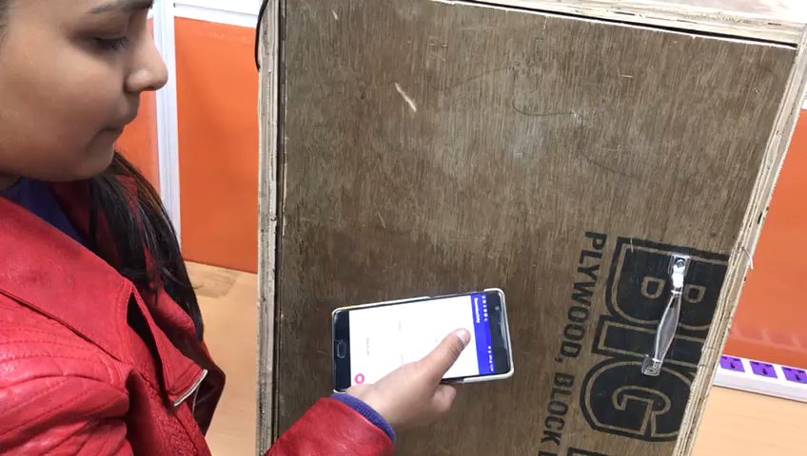

Slide 6
THANK YOU

